Slide 1
FLIGHT MANAGEMENT SYSTEM
Team Members:
Mohammed Thouseef
Vikas Vishwakarma
Rohan Kachare
Notes:
Add instructor notes here.

Slide 2
OBJECTIVES
Project Understanding
Approach used
Project Execution
Modules
Learning
Best Practices
Opportunity for Improvement
Notes:
Add instructor notes here.

Slide 3
PROJECT UNDERSTANDING
The main objective of this project is to design and develop an Flight Management System.
Flight Management System is used by User to view, book and modify flight tickets for their journey.
The Flight Management System is used by Admin to add ,view and delete a flight.

Slide 4
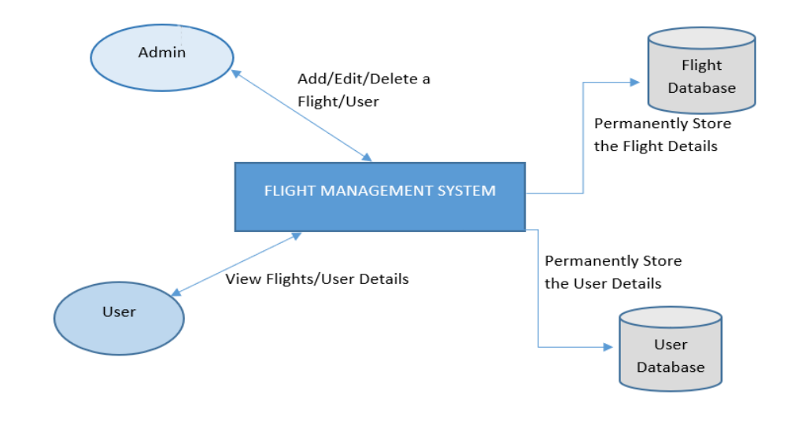
High Level Design Diagram

Slide 5
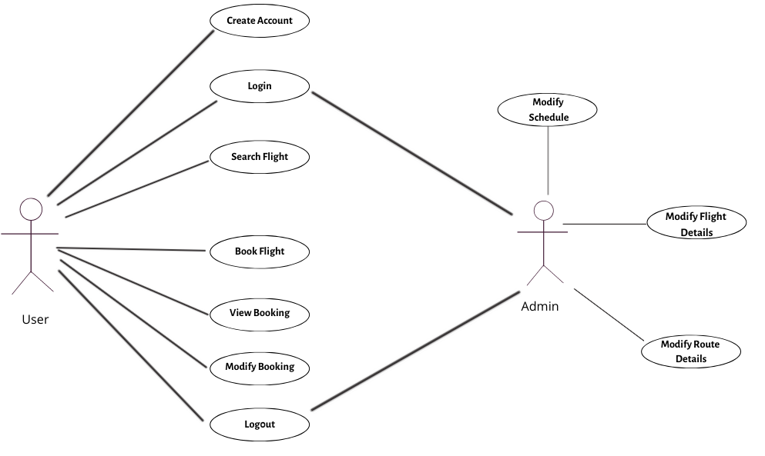
USE CASE DIAGRAM

Slide 6
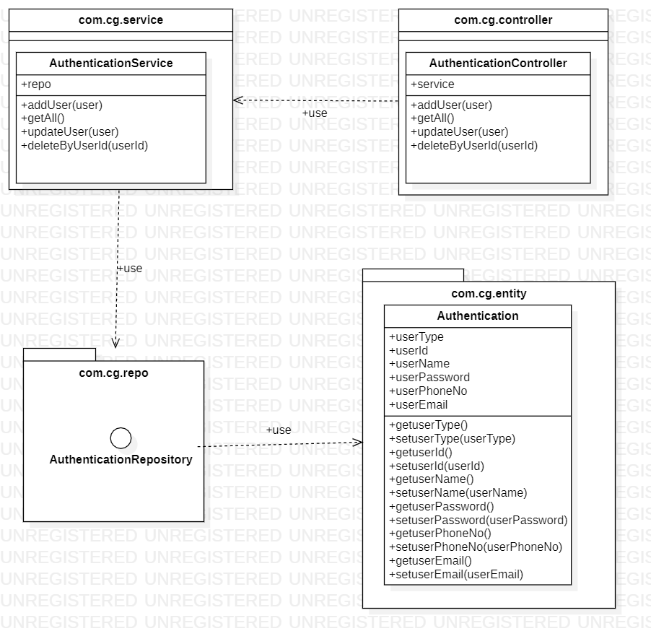
CLASS DIAGRAM FOR AUTHENTICATION MICROSERVICE

Slide 7
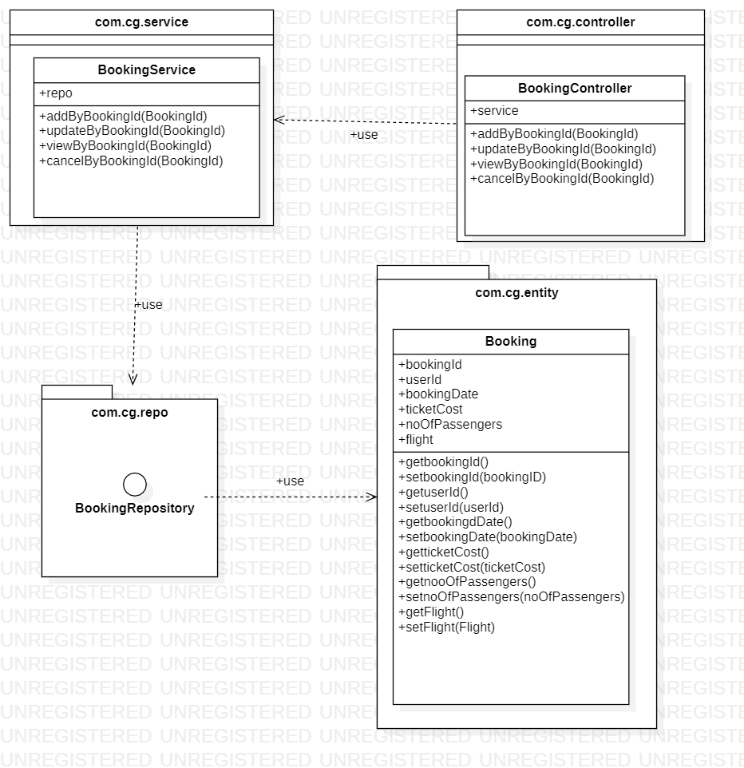
CLASS DIAGRAM FOR BOOKING MICROSERVICE

Slide 8
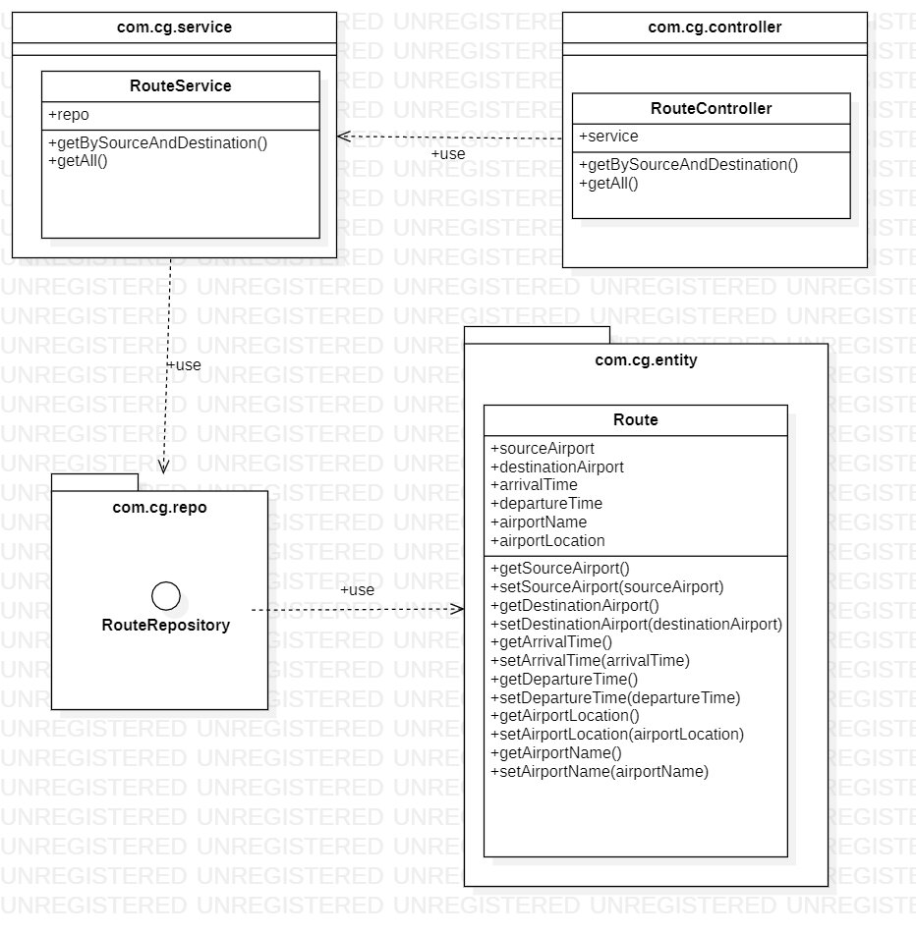
CLASS DIAGRAM FOR ROUTE MICROSERVICE

Slide 9
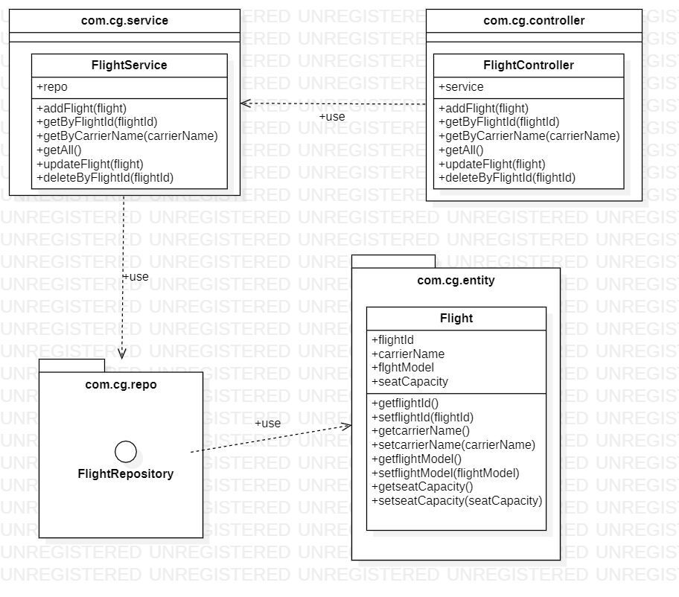
CLASS DIAGRAM FOR FLIGHT MICROSERVICE

Slide 10
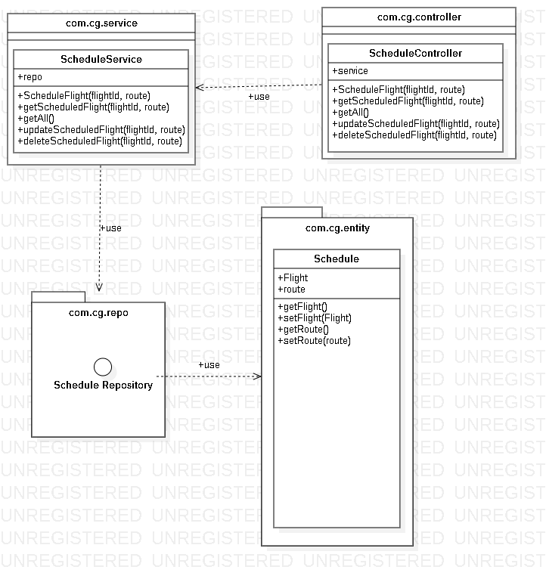
CLASS DIAGRAM FOR SCHEDULE MICROSERVICE

Slide 11
APPROACH USED
    Front End & Web Components:–
      Angular 8
    Business Logic Components and Services :-
      -Spring Boot
      -Microservices
    Databases:-
      -MySQL(cloud)

Slide 12
PROJECT EXECUTION
Login Module
User Module
Admin Module

Slide 13
LOGIN MODULE
Login:
User can login into the application through his/her login credentials.
Admin can also login in the application.

Slide 14
USER MODULE
User:
Login into application.
Search the flight for the desired route.
Select Flight and make a booking by filling the required details.
View the booking details.
Modify or Cancel booking.
Logout.

Slide 15
ADMIN MODULE
Admin Module:
Login into application.
Add ,View and Cancel the flight details.
Add ,View and Cancel the schedule details.
Add ,View and Cancel the route details.
Logout.

Slide 16
LOGIN MODULE
User Module:
Login module is common for both user and Admin.
Take login credentials from the user.
If login credentials are wrong, will give error message .
If login is successful, will navigate to application.

Slide 17
LOGIN MODULE
Admin Module:
Take login credentials from the Admin.
If login credentials are wrong, will give error message .
If login is successful, will navigate to application.

Slide 18
LEARNING
We have implemented the Flight Management project, using Spring boot framework with JPA and Microservices.
We have learned to work as a team.
Time Management and division of work.
Supporting team members in the work.

Slide 19
BEST PRACTICES
Followed placing comments in appropriate places
Followed naming conventions.
Followed proper indentation.

Slide 20
OPPORTUNITY FOR IMPROVEMENT
The following features can be further implemented to improve the project:-
-Addition of Extra features like Add-ons, Payment Option, etc.

Slide 21
MVP PLAN
MVP | Product | Start Date | End Date | Remarks
1 | Login Authentication | 09/06/2020 | 10/06/2020
2 | User Module | 10/06/2020 | 11/06/2020
3 | Admin Module | 11/06/2020 | 12/06/2020
4 | Deployment | 12/06/2020 | 14/06/2020

Slide 22


